Slide 1
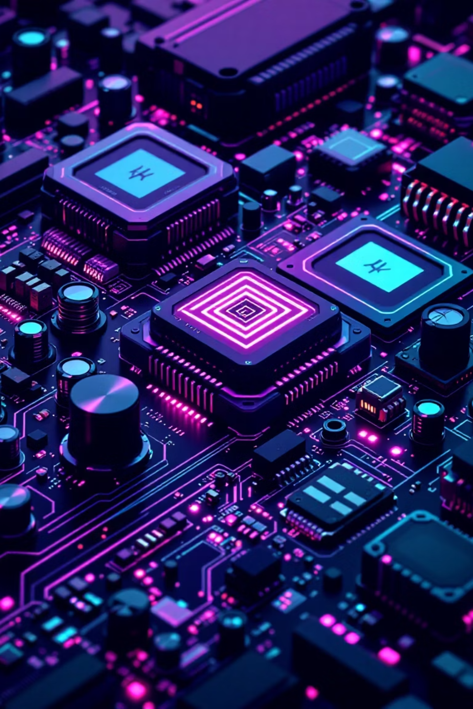
Essential Components for Next-Gen Robotics & IoT
This presentation introduces the core components that form the backbone of innovative robotics and Internet of Things (IoT) projects. From powerful microcontrollers to precise sensors and robust actuators, each element plays a crucial role in bringing your ideas to life.

Slide 2
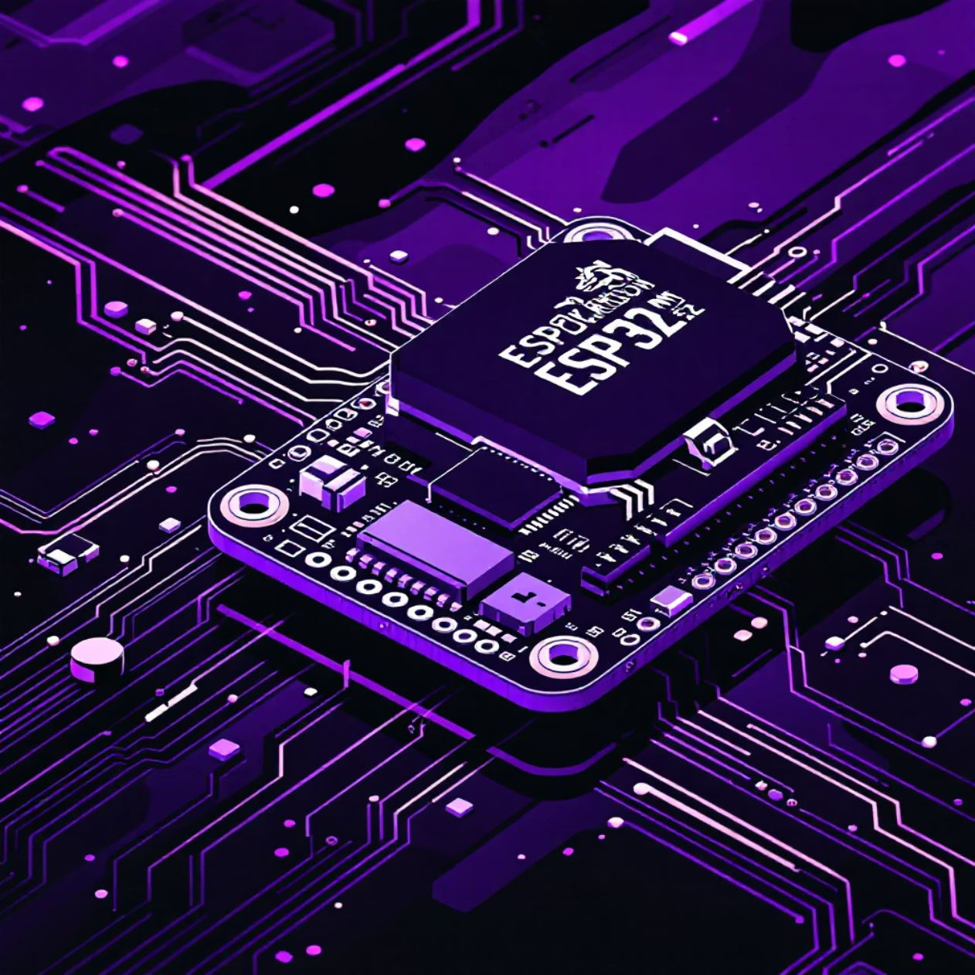
ESP32-WROOM-32: The IoT Powerhouse
The ESP32-WROOM-32 is a highly integrated, powerful microcontroller renowned for its dual-core processing capabilities and extensive connectivity options. It's the brain of countless smart devices.
Dual-core 32-bit Xtensa LX6 CPU, up to 240 MHz clock speed
Integrated Wi-Fi (802.11 b/g/n) and Bluetooth (classic & BLE) for seamless communication
520 KB RAM, supporting up to 16 MB external flash for robust applications
22 GPIO pins with rich interfaces: SPI, I2C, UART, ADC, DAC, offering vast expansion possibilities
It's ideal for smart devices, embedded systems, and complex IoT applications requiring both processing power and network capabilities.

Slide 3
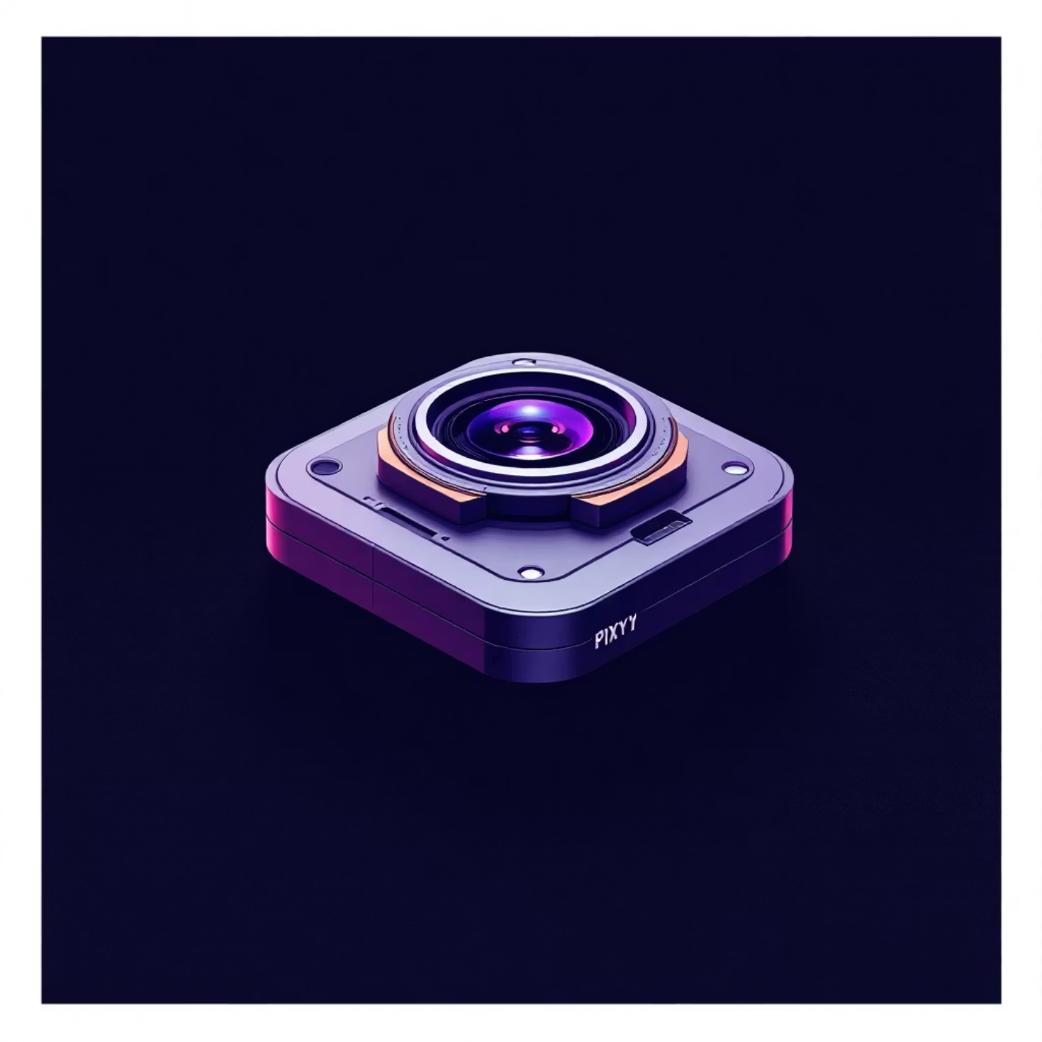
Pixy 2.1 (CMUcam5): Vision Sensor for Robotics
The Pixy 2.1 (CMUcam5) is a compact, intelligent vision sensor designed to bring visual perception to robotics projects without overwhelming the main microcontroller.
Fast object recognition and tracking with onboard processing, freeing up your main CPU
Supports color-based object detection, making it easy to identify specific items
Multiple interface options: SPI, I2C, UART, or USB for flexible integration into any system
Enables real-time vision tasks, such as line following or object sorting, with minimal latency
It's an invaluable tool for robots needing to interact with their environment visually.

Slide 4
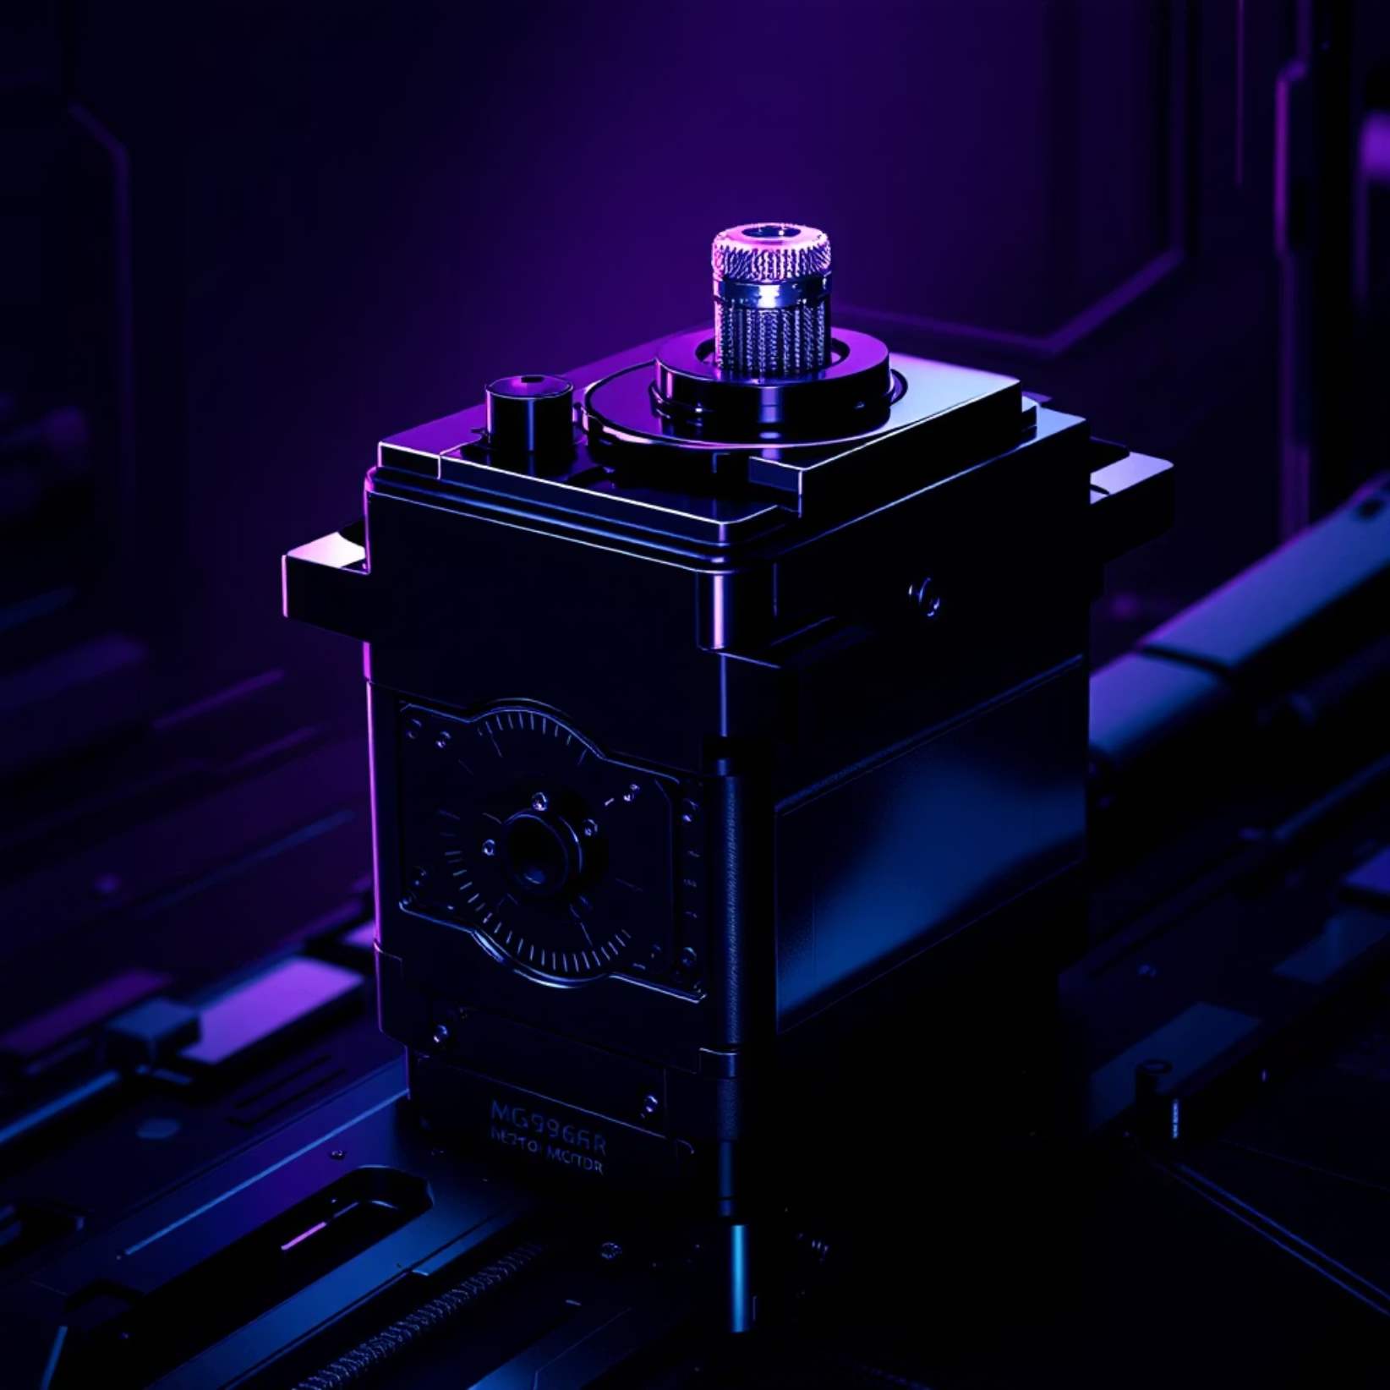
MG996R Servo Motor: High Torque Actuator
The MG996R Servo Motor is a popular choice for roboticists due to its impressive torque and durability, crucial for precise movements.
Metal gear design ensures longevity and precise positioning, even under load
High torque output: up to 9.4 kg·cm at 6V, making it suitable for driving robotic joints and mechanisms
Operating speed of approximately 0.17 sec/60° at 6V, offering a good balance of speed and power
Widely used in both hobbyist and professional servo applications, from RC cars to articulated robot arms

Slide 5

JGA52-370 12V DC Motor: Reliable Power for Movement
Consistent Performance
The JGA52-370 12V DC Motor provides a dependable source of mechanical energy, essential for driving wheels or other moving parts in your projects.
Balanced Speed & Torque
Features a 12V rated voltage, offering a good balance of speed and torque suitable for a wide range of applications.
Versatile Application
Commonly found in small robotics, automated systems, and various DIY projects where controlled rotational motion is needed.
Easy Integration
Seamlessly compatible with motor drivers like the L298N, simplifying its control and integration with microcontrollers.

Slide 6

L298N Motor Driver: Dual H-Bridge Controller
The L298N Motor Driver is a versatile module that bridges the gap between low-power microcontrollers and high-power motors, allowing precise control.
Controls two DC motors or one stepper motor simultaneously, offering flexibility for different robotic setups
Supports up to 2A per channel with a built-in heat sink, ensuring stable operation even under higher loads
Enables both direction and speed control of motors via PWM signals, providing fine-grained command
An essential component for driving various motors with microcontrollers like the ESP32, protecting the microcontroller from motor current spikes

Slide 7




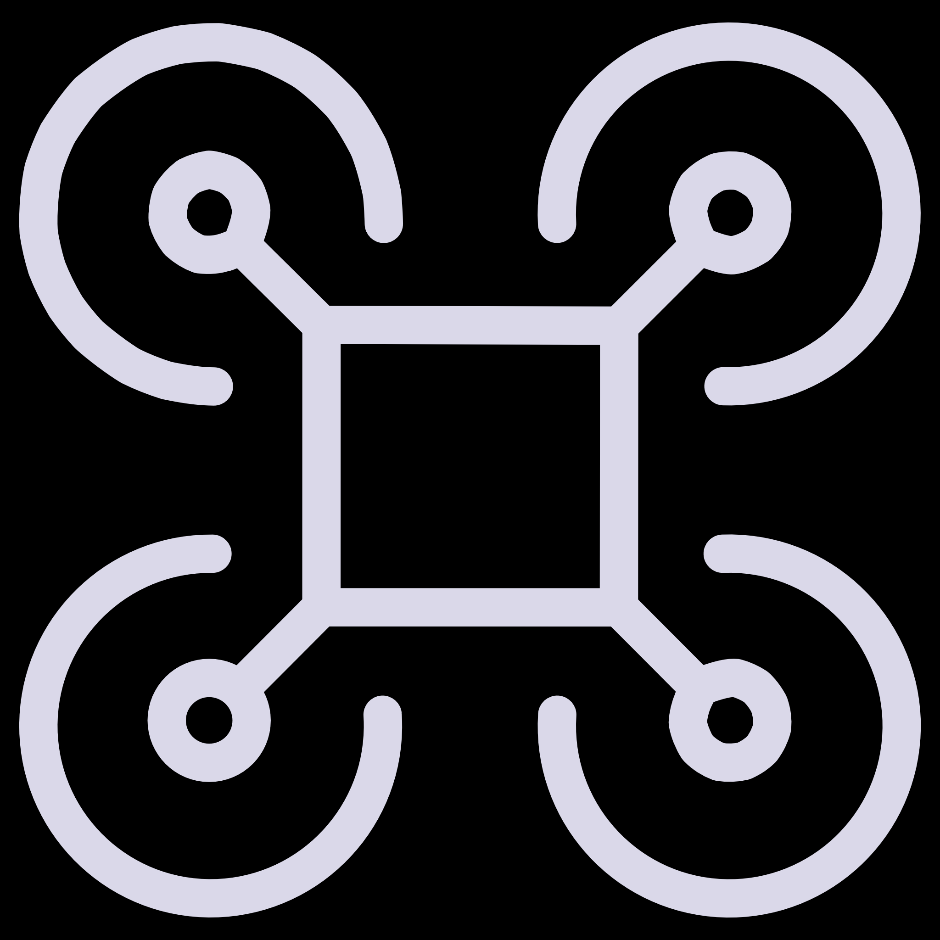
MPU6050 Gyroscope & Accelerometer: Motion Sensing
6-Axis Motion Tracking
Combines a 3-axis gyroscope and a 3-axis accelerometer for comprehensive motion data.
I2C Interface
Offers easy communication with microcontrollers like the ESP32, simplifying integration.
Orientation & Gesture
Crucial for applications requiring precise orientation, gesture detection, and stabilization.
Versatile Applications
Widely used in drones, robotics, and wearable devices for real-time motion analysis.

Slide 8




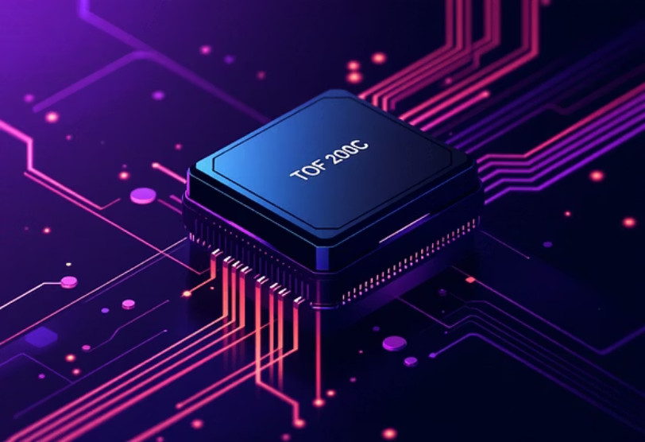

TOF Sensors: TOF 200C & TOF 400C Overview
Time-of-Flight Principle
TOF 200C: Short-Range Precision
Both TOF 200C and TOF 400C utilize Time-of-Flight technology for highly precise distance measurements.
Compact and efficient, ideal for close-range applications with a detection range of up to 2 meters.
TOF 400C: Extended Accuracy
Obstacle Detection & Proximity
Offers an extended range of up to 4 meters with higher accuracy, suitable for more demanding environments.
These sensors are invaluable for obstacle avoidance in robots and precise proximity sensing in various automation tasks.

Slide 9

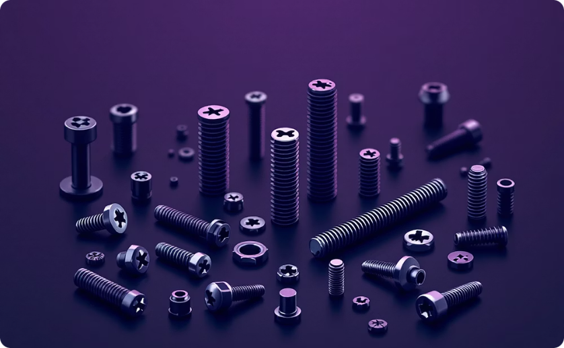
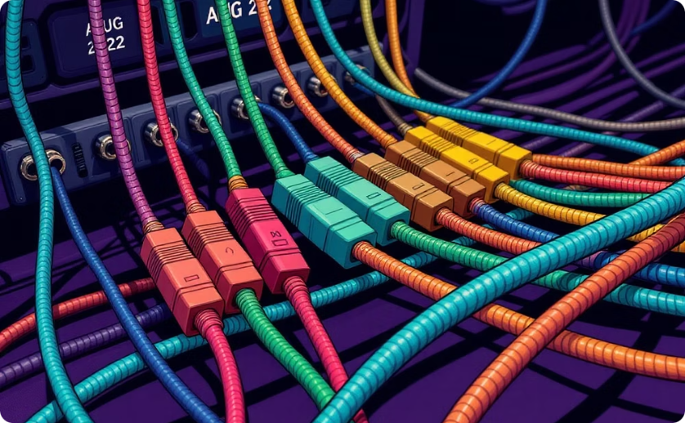
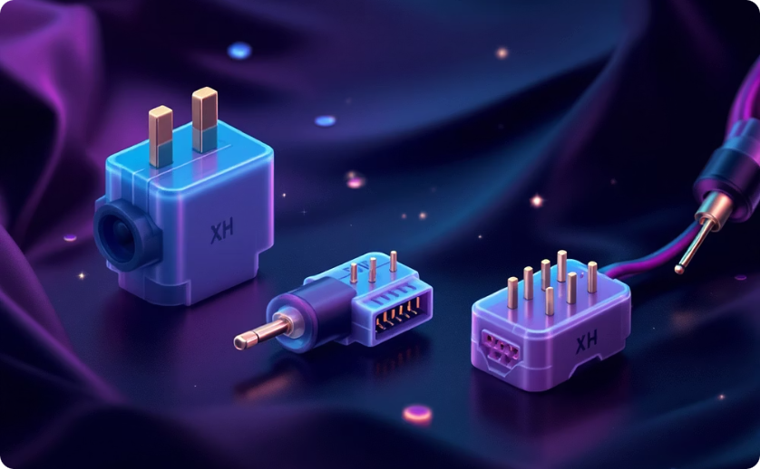

Mechanical & Electrical Essentials
Metal Gear Set
M3 & M4 Screws
AUG 22 Wires
XH Connectors
Ensures robust and reliable mechanical power transmission, critical for motor systems and moving parts.
Standard fasteners for secure assembly, mounting components, and constructing durable frames.
Provides reliable electrical connections for power and data, crucial for interconnecting components.
Offers secure and convenient plug-in connections for modularity and ease of assembly/disassembly.
4.3” OLED Display
A high-contrast, low-power screen ideal for user interfaces, displaying data, and interactive control panels.

Slide 10

Bringing It All Together: The Synergy of Components
L298N (control)
Pixy 2.1 (vision)
Motor driver interface
Object detection and tracking
TOF Sensors (ranging)
ESP32-WROOM-32 Hub
MG996R Servo (motion)
Distance measurements
Precise pan/tilt control
MPU6050 (sensing)
JGA52-370 Motor (power)
IMU data: accel & gyro
Drive and propulsion torque
Each component plays a vital and interconnected role in building smart, responsive systems. The ESP32-WROOM-32 acts as the central brain, seamlessly integrating inputs from sensors, controlling motors, and managing displays.
By combining advanced vision, precise motion control, accurate sensing, and intuitive user interfaces, we can enable advanced robotics and sophisticated IoT projects. These powerful building blocks empower you to innovate and create the next generation of intelligent machines!

